Slide 1
Knapsack Type
Laser Cleaner
V1.0

Slide 2
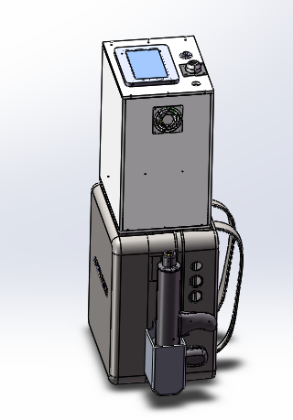
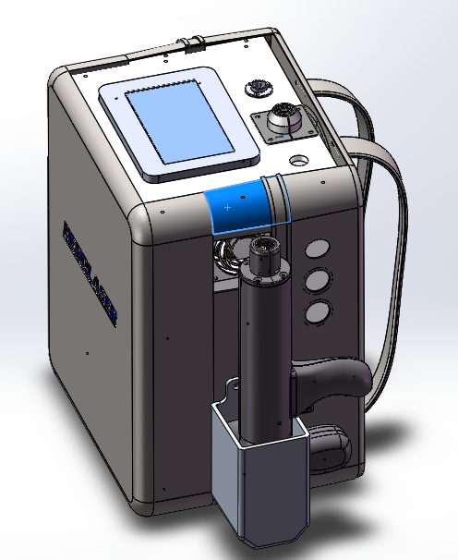
Equipment Introduction
1.1 Cleaner layout
displayer
布料背包
Laser device
braces
knapsack
450mm
logo
Laser cleaning head
305mm
460mm
285mm

Slide 3
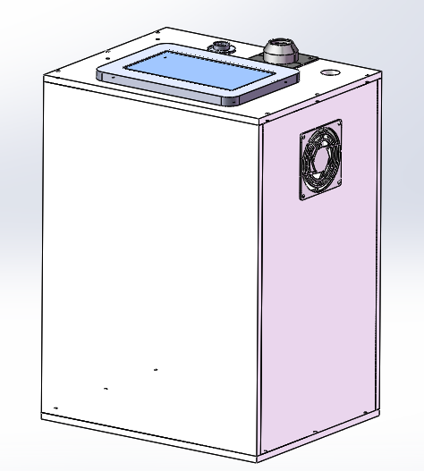
Ⅲ Equipment Introduction
1.2 The laser cleaning machine equipment adopts acrylic material to constitute the box structure, the purpose is to reduce the weight, reduce the artificial load-bearing force.
The whole machine is designed for compact type, the purpose is to reduce the space area, more convenient manual operation.
Item | Parameter
Laser power | 100W
type | Fiber laser generator
Wave length | 1064nm
Cooling | AN
Total weight | 38KG
Total power | 800W
Length of fiber laser | 3m
Scam width | 10~80mm
Auxiliary gas | Compressed air
Air pressure | 0.5-0.8Mpa
Operating temp. | 0~40℃
Dimension | 460x285x450mm
416mm
306mm
246mm

Slide 4
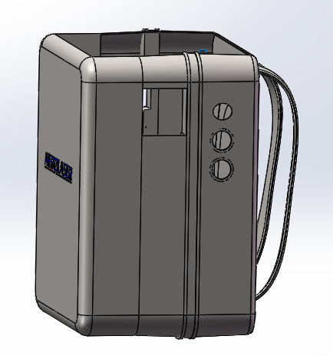
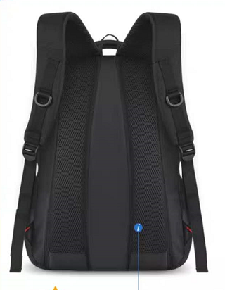
Equipment Introduction
1.3 Introduction of knapsack
In line with the size of laser cleaning equipment, the bag is customized with polyester fabric.
Purpose one: in order to reduce the bearing force of the operator;
Purpose two: for the operator in the back equipment when the back contact foam will be more comfortable.
With foam in the back

Slide 5
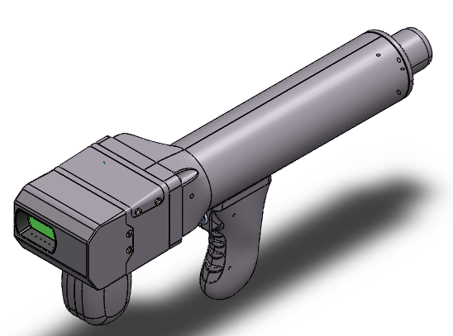
Equipment Introduction
3.4 Introduction of handheld cleaning head
Customized Herolaser handheld cleaning head
Practical, small in size and light
372mm
167mm
89mm

Slide 6
Equipment configuration
2.1 Main configuration (component list)
S/N | Name | Brand | Spec. | No. | Unit | Note
1 | Laser generator | At client’s option | 100W | 1 | Set
2 | Cleaning machine | Herolaser | CD004003-001D | 1 | Set
3 | Knapsack | At client’s option | customized | 1 | Set
4 | Cleaning head | Herolaser | QXSC01 | 1 | Set
5 | Electronic components | Schneider and similar brands | / | 1 | Set

Slide 7
Operating condition
(1) Environmental requirements
The equipment can meet the environmental suitability requirements of Marine manufacturing equipment.
(2) Power supply requirements
A. Power requirements of single-phase AC 220V±5%, 20A above.
B. regulated power supply input port should be installed more than 20 a single-phase air switch, grounding resistance is not greater than 4 Ω.

Slide 8
Commitment
The equipment has reasonable structure design and stable performance.
Under normal operation condition, the production rate is more than 90%.
The noise of the equipment is below 80 decibels, and the whole line does not contain non-environmental protection materials.
We guarantee that the equipment provided has no defects or defects in design, material selection and manufacturing process, and complies with laws, regulations and technical and quality requirements agreed by both parties.
The whole equipment warranty 1 year, lifetime to provide the equipment accessories and technical support.

Slide 9
Commitment
f. After the warranty period, if the equipment parts are damaged and need to be replaced, only the cost of replacement parts will be charged, free of service charge.
When the equipment is delivered to use, 1 set of wearing parts, 1 set of maintenance toolbox and 2 manual books will be randomly delivered to the equipment, and the personnel designated by your company will be trained on the operation and maintenance of the equipment for at least 1 week.

Slide 10

06服务承诺

